Slide 1


NEXT3
New Education for Cross-Border Technologies
Building a future that is greater than borders
Kick-off 26 October 2026

Slide 2

















Consortium partners and co-financers

Slide 3
Kick-off
agenda
- recap of the work packages, activities, deliveries and project planning
proposal for the project governance structure
periodic reporting
introduction Interreg: guidelines and communication requirements
AOB

Slide 4

Recap: why do we need a Trinational Approach?
The Challenge
  Economic / energy / circular transition requires new skills
  Companies lack cross-border expertise
  Talent retention and talent attraction <-> brain drain
  Position of the (eu)region between surrounding agglomerations (Randstad, Brainport, Vlaamse Ruit, Rhein-Ruhr …)
  Education is fragmented: national focus <-> (lacking) euregional approach
  Underutilized potential: euregional cross-border opportunities often overlooked or inhibited by barriers

Slide 5
Recap: why do we need a Trinational Approach?
The Challenge
  Lacking cross-border education
  Limited industry alignment
  Lacking (staff and) student mobility and development of cross-border perspective

Slide 6
Recap: why do we need a Trinational Approach?
The vision
  One region, one learning ecosystem
  Interdisciplinary (holistic), cross-border (euregional) perspective
  Alignment of educational offer and (joint) development of additional offer to close gaps
  Built with industry

Slide 7
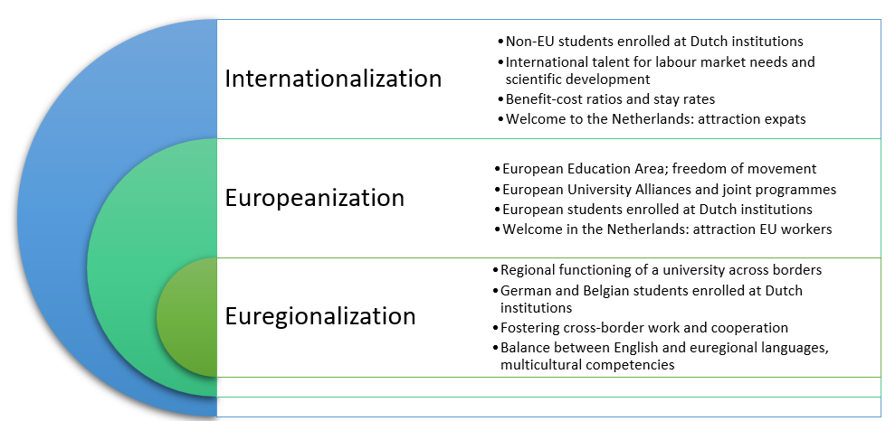
Perspectives
Euregional reality
Students from neighbouring regions
Housing possibilities across border
Language(s): not only English..
Internationalisation policies in neighbouring countries

Slide 8
How are we going to do this?
  Combine education, research, and industry collaboration
  Focus on real-life challenges in Engineering & Computer Science
  Use a phased implementation approach (pilot → scale)
Notes:
3

Slide 9

Flexible, Student-Centered Curriculum
  Develop a modular “menu-based” curriculum across NL–DE–BE
  Allow students to build their own learning pathway based on interests
  Combine modules from different institutions into one coherent track
  Ensure academic alignment and recognition (ECTS compatibility)
  Explore options for shortened pathways and seamless learning tracks
  Start embedded in existing programs, evolve towards flexible pathways

Slide 10
Attracting and Supporting Students
  Offer a clear and structured mobility experience (full semester at a partner institution)
  Provide clear added value (skills, CV, international experience)
  Ensure strong guidance and coaching
  Arrange a consistent academic and social environment abroad
  Use peer ambassadors & success stories

Slide 11
Working with Real Challenges
  Co-create projects with regional companies
  Focus on practical cases
  Involve companies in mentoring and evaluation
  Create pathways to internships and jobs

Slide 12
From Pilot to Impact
  Start with pilot groups (small quantity, high quality)
  Evaluate and improve after each iteration
  Scale to more students and programs
  Ensure financial sustainability (clear cost model, tariffs)

Slide 13
Our Shared Ambition
From Border Region to Integrated Educational Space
  Highly dense cross-border European region (NL–DE–BE)
  Strong functional integration in labour markets and daily life
  Education systems still primarily organised nationally
  Structural opportunity: proximity as an underused advantage

Slide 14
Learning Space Concept
  Early exposure to language & culture
  Structured school-level cooperation & Euregio programmes
  Emerging cross-border study & training pathways
  Education as a continuous regional learning trajectory
Notes:
Speaker notes:
We want to think education as a continuous pathway rather than isolated stages.
This starts early, already in kindergarten and primary education, where language and cultural exposure can build natural familiarity with neighbouring countries.
In secondary education, this develops into structured exchange and joint learning formats, where cooperation becomes part of everyday schooling.
In vocational and higher education, we aim for structured cross-border pathways, where students can move more easily between systems and institutions.
The key idea is continuity: not one-off mobility, but a coherent educational trajectory across borders.
9

Slide 15
Ownership & Stakeholders
  Creating enthusiasm & ownership at university stakeholders
  Euregios as network facilitators and regional competence hubs
  (= Demand for coordination from education stakeholders)
  Ministry of Education as key institutional partner at national level should be visible in the region
  Need for alignment across three countries and systems
Notes:
Speaker notes:
In this process, the Euregios play a central role as network facilitators.
They act as regional competence hubs, connecting institutions, identifying needs, and translating them into cooperation structures.
At the same time, we see a growing demand from the education sector itself for exactly this type of coordination and support.
On the institutional level, cooperation with ministries such as OCW is essential, because we are working across three different national systems.
This requires alignment, trust, and shared responsibility beyond individual projects.
10

Slide 16
Vision Outcome
  Integrated cross-border education space
  Diversity as a structural strength
  Talent retention and attraction
  Education as regional USP
  Towards a trinational educational space
  Towards a trinational curriculum
  Towards a Euregional University
Notes:
Speaker notes:
Our long-term vision is a fully integrated cross-border educational space.
A region where linguistic and cultural diversity is not a challenge to overcome, but a structural strength.
A region that retains talent by offering attractive and diverse educational pathways.
And a region that also attracts students and professionals from outside the immediate area because of its unique cross-border profile.
In this way, education becomes a key driver of regional competitiveness (or : competitive advantage)
Or in simple terms:
from border to connection – and from connection to strength.
11

Slide 17
Reflection on work packages

Slide 18
1. Harmonizing educational policies – Zuyd (Agnes)
1.1 | Inventory of Existing Legislation and Regulations
1.2 | Highlight points of improvement and potential synergy between the three systems
1.3 | Create a cross-national country qualification equivalence map
1.4 | Analyse recognition procedures for training schema's, credits (and micro-credentials)
1.5 | Organise regulatory/Quality Assurance expert consultations (trinational)
1.6 | Align with CrossCircular on regulatory interfaces only

Slide 19
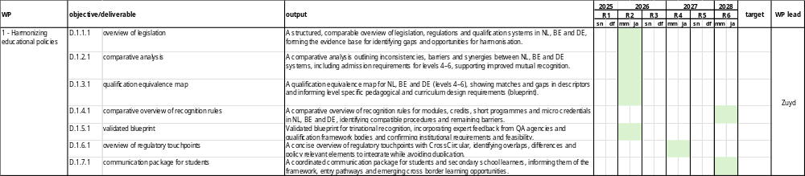

Slide 20
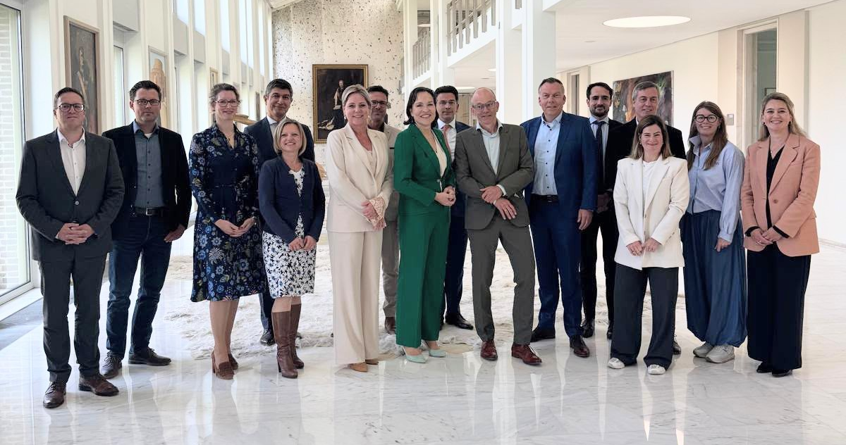
Rapport before Xmas!

Slide 21
2. Vision on cross-border / cross-cultural education – FH Aachen (Alexander)
2.1 | Evaluation and comparison of existing learning methods/frameworks
2.2 | Study on different learning methods and integration in the blueprint
2.3 | Collect educational expectation from the industry together with 3.2 (SSL)
2.4 | Definition of the learning methods for different levels of education
2.5 | Matching of learning methods with WP3
2.6 | Testing the teaching methods and establishing a framework
2.7 | Manual for Coach

Slide 22
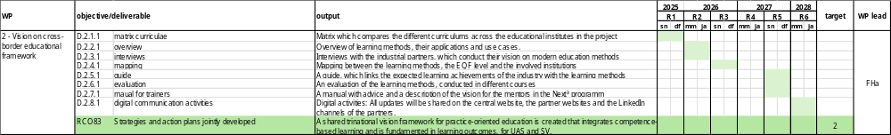

Slide 23
3. Curriculum co-creation – UCLL (Tobias)
3.1 | Establishment and Coordination of a regional captain table
3.2 | Discussion with industry on gaps in the current system and needs of the industry ( SSL)
3.3 | Evaluation and comparison of existing curriculums
3.4 | Mapping of Living Labs & Facilities
3.5 | Development of a Cross-Border Co-Creation Framework (incl. learning outcomes, assessment)
3.6 | Planning Sharing of Living Labs & Facilities in the Framework
3.7 | Development of a Handbook (Study Guide) for Cross-Border Traineeships
3.8 | Development and Implementation of curricular and Extracurricular Activities
3.9 | Train the Coach

Slide 24
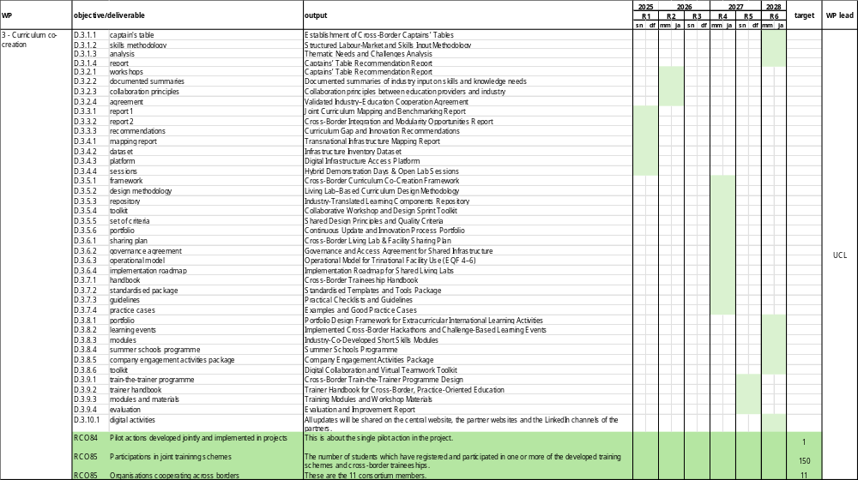

Slide 25
4. Tooling for sustainable education-industry integration – HELMo (Oliver)
4.1 | Requirements and architecture for the cross-border digital collaborative interface
4.2 | Selection/adaptation of digital tools and interoperability layer
4.3 | Implementation of the trinational digital collaborative interface
4.4 | Guidelines, training and sustainability plan
4.5 | Student tracking system ( coach support)

Slide 26
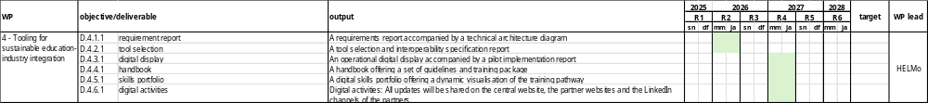

Slide 27
5. Testing and validation – Fontys (Gerard)
5.1 | Installation of a quality commitee
5.2 | Development of a quality procedure manual
5.3 | Development of test criteria (guiding qualities)
5.4 | Development of quality policy document to guarantee the sustainability
5.5 | Development of test assurance maual

Slide 29
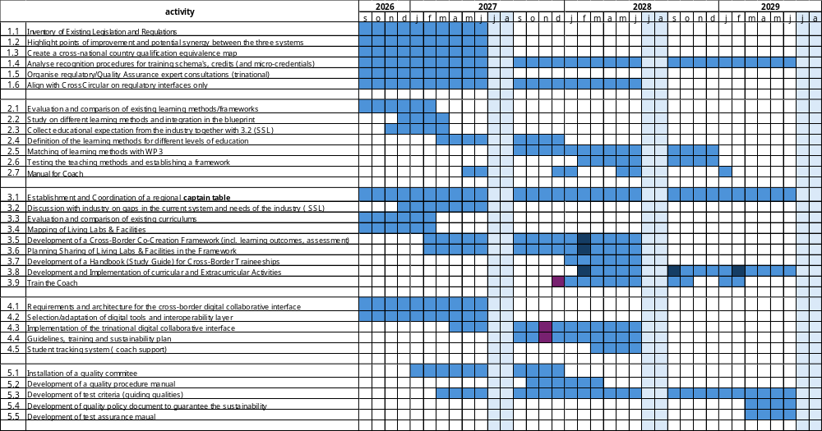

Slide 30
Participants list

Slide 31
Governance
structure
- two/three-wekely WP meetings
realisation of the work packages based on the work plan of the WP-leaders
participation: specialists from the partner organisations
- two-three-monthly partner meetings
discuss the progress of the project and possible challenges and decide upon way forward and proposals
participation: representatives from partner organisations (i.e. kick off excl. finance)
- bi-annual consortium meetings
share the overall progress
participation: all stakeholders from the partner organisations

Slide 32





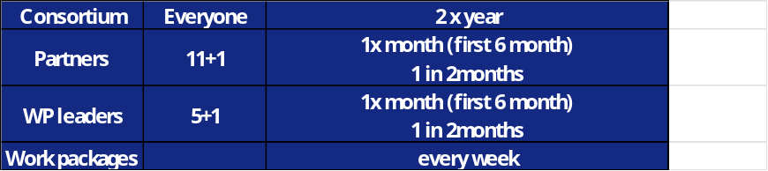
Do we have agreement on who should participate in each type of meeting (consortium, partners, WP leaders, and individual WPs)?
Does the meeting schedule support progress without creating unnecessary workload?
Could some meetings be combined to reduce overlap and improve efficiency?
Does the current planning support effective collaboration and decision-making?
What improvements would you suggest to streamline the meeting structure?

Slide 33
Procedures
partner and project reports
partner report every 3 months – to be submitted through Jems max. 4 weeks after end reference date
short description of partner’s activities
submission of incurred and paid expenditure
project report every six months on project level
input from WP leaders
official payment request of certified partner reports

Slide 34
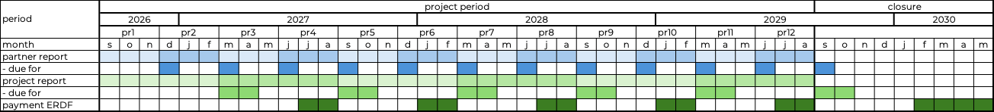
Procedures
partner and project reports

Slide 35
Procedures
preparation
partner JeMS training
embed hourly registration in partner organization
own automized time registration procedure?
otherwise: template available
start collecting substantiation documents
payslip of staff members involved (September 2026 or month start date activities)
labour contract

Slide 36
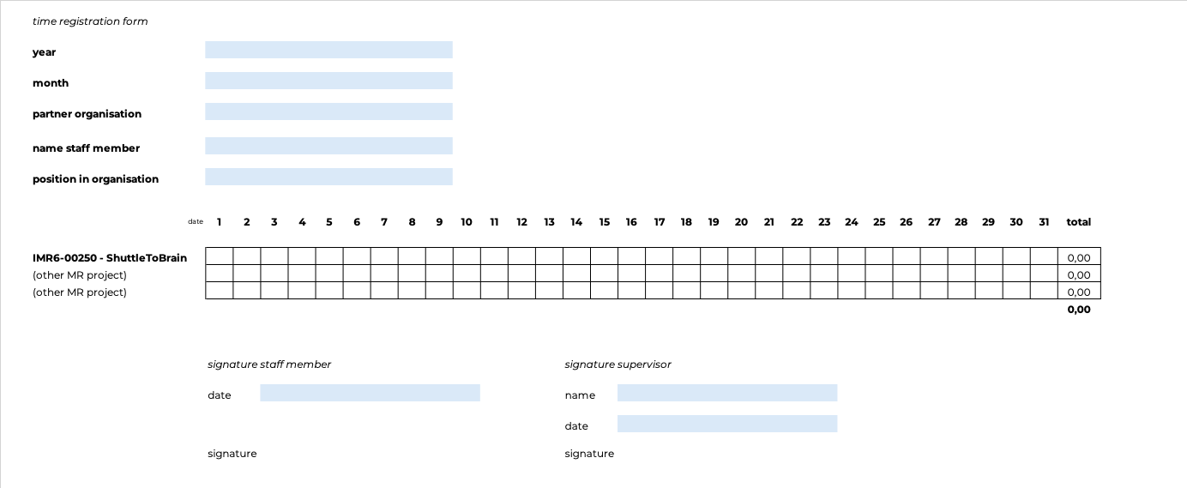
Procedures
time sheet

Slide 37
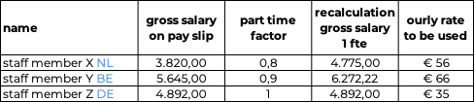
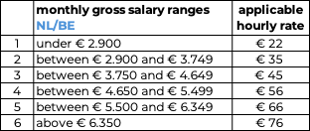
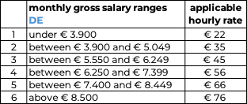
Procedures
calculation hourly rate

Slide 38
Practicalities
implementation
support in partner reporting
project tool to be provided
overview deliverables and planning
per partner budget, planning and realisation

Slide 40
Welcome
Kick-off Meeting
IMR6-00180 – NEXT3
26.10.2026
Notes:
Add the project name and the date of the meeting

Slide 41
Agenda
 | Introduction
 | Role of the Joint Secretariat & the Project Manager
 | Key Documents
 | General aspects of project implementation
 | Communication
 | JEMS - Monitoring
 | Conclusion

Slide 42
Introduction
Notes:
Introduction round of everyone attending

Slide 43

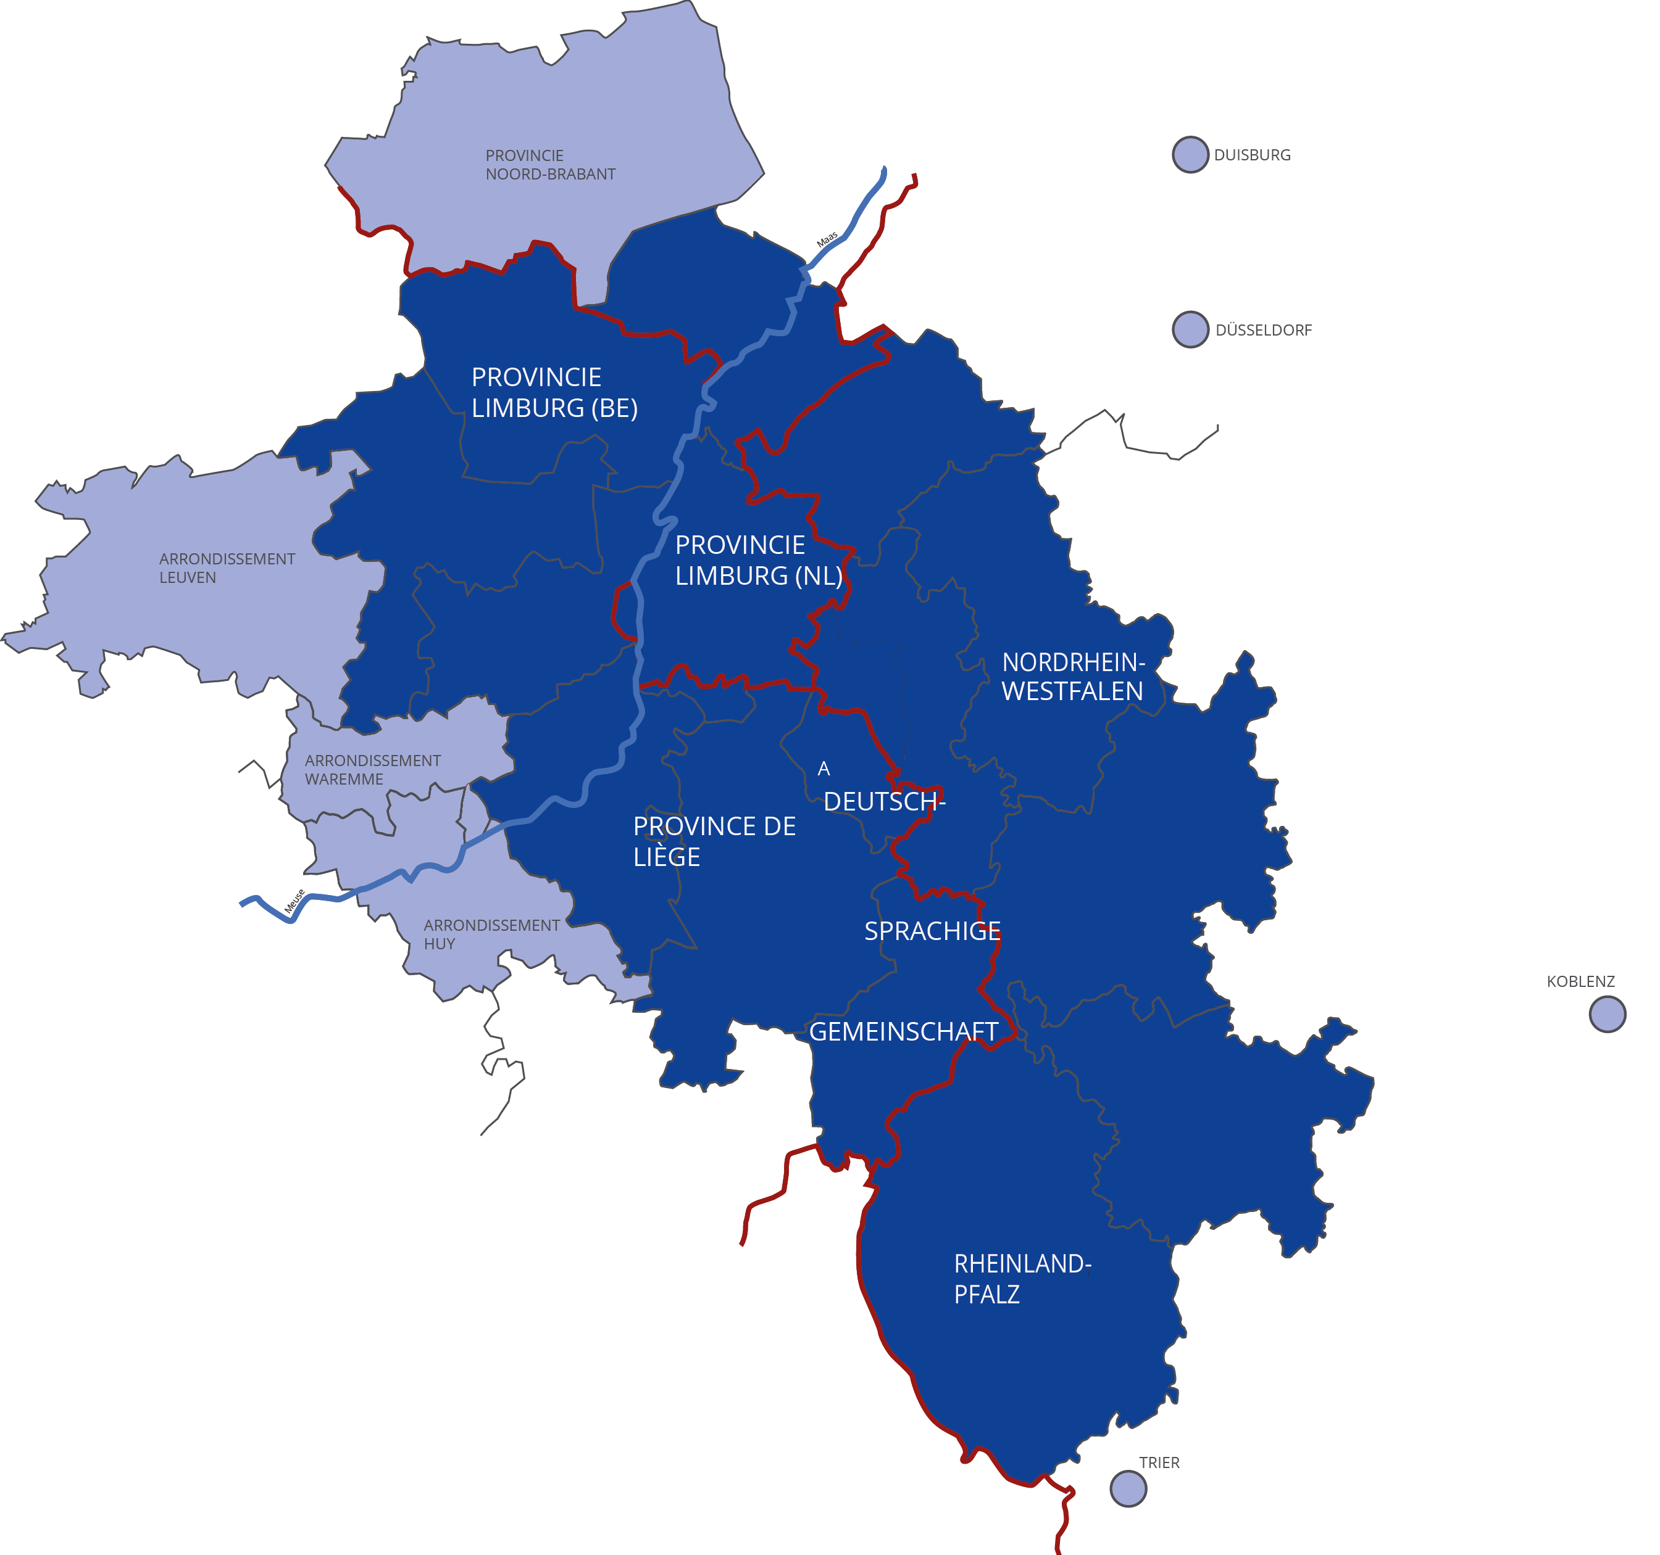










Programme Area
Notes:
General info about the programme, partners and area. Dark blue is programme area. Light blue are functional area.

Slide 44
More information
Programme website
  Homepage (interregmeuserhine.eu)
Contacts
  Contact (interregmeuserhine.eu)

Slide 45
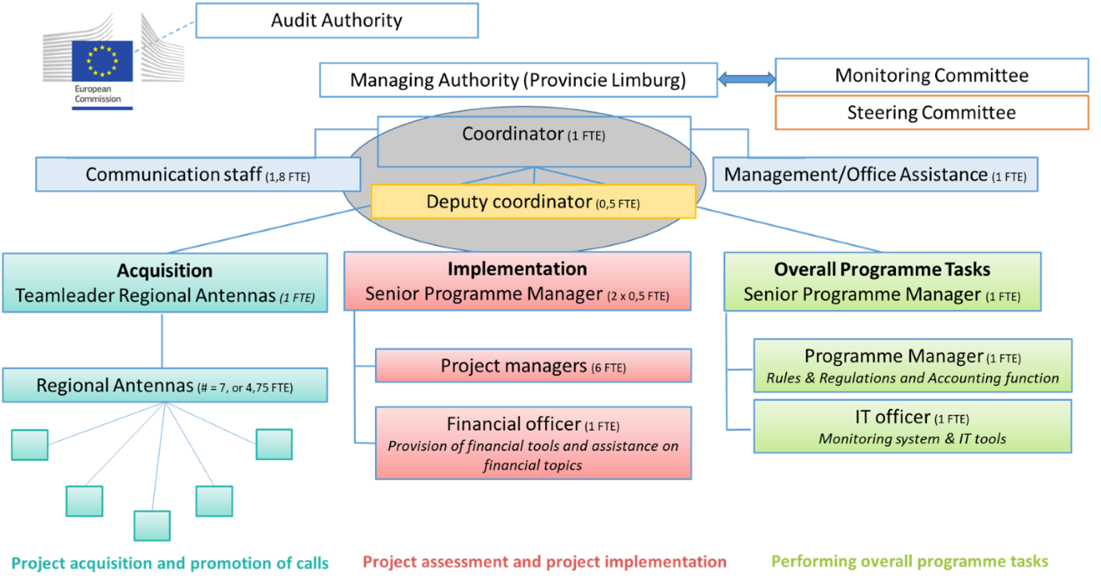
Interreg Meuse-Rhine Office
Notes:
Programme’s organisational chart.
Point to why main contact switches from Regional Antennas to Project Managers after step 2 submission of application.

Slide 46
Role of the Project Manager
Administrative support during project implementation phase​
JEMS
Management Verifications (checks on reports and on-the-spot)
Regular contact with projects
Therefore please:​
Invite us to your events​
Inform us about progress & changes
Ask us if you have questions about implementation, finances, indicators, reporting, monitoring…

Slide 47
Your main contact point
Joint secretariat
  Main Project Manager Back up
  Laurie Martine Jambu Tanne Rademakers
  +31 (0)6 41394740 +31 (0)6 21306021
  lcd.martinejmabu@prvlimburg.nl t.rademakers@prvlimburg.nl
Lead Partner Principle:
All direct contact with the JS goes through the Lead Partner.
Notes:
Add names and contact info specific for the project. Emphasize role of the lead partner. First point of contact not Regional Antennas anymore.

Slide 48
Key Documents

Slide 49
Key Documents
Cooperation programme Interreg Meuse-Rhine (NL-BE-DE)
Subsidy Regulations
Your obligations as a beneficiary
Legal basis
Cost Catalogue
General principles (4 categories)
Manual
Covers everything from project generation to project closure
General frame for the programme
Payment & closure procedure
Selection procedure & criteria
Calculation of costs
Simplified Cost options
Priorities, specific objectives & indicators
Differ per call
Documents required
Downloads (interregmeuserhine.eu)
Notes:
Reminder of cost option

Slide 50
Selection Letter
Grant decision = legal contract between programme and project (Lead partner)
Based on your application form
Amount of maximum ERDF-subsidy (60%)
Annexes:
1. Overview of total budget and financing per partner, including state aid
2. Explains decision and gives recommendations
3. Explains indicators and their target values
4. & 5. Optional co-funding from Ministerie EZ and NRW
Notes:
Legal contract!
Reminder of the info. State aid info. Pay attention to recommendations in Annex 2!

Slide 51
General aspects of project implemen-tation

Slide 52
Regular exchange with Project Manager
As often as necessary
About 3 times per project with all partners
After every project report with the Lead Partner
  Assessment of project report & progress
  Recommendations & attention points

Slide 53
Reporting
Notes:
Lead partner principle

Slide 54
Checks on reports
MA/JS will perform risk-based checks on partner reports (RBMV)
  Risk-assessment is done every partner report
  Identified risk profile (5 categories ranging from “very high” to “very low”) determines the amount of cost lines being checked
  Every partner starts at “very high”, to build up project-specific risk profile
  Quality of certain report (number and financial impact of findings) influences the risk profile (and thus RBMV-approach) for next report
Notes:
Documents depend on applicable cost option (1, 2, 3 or 4).

Slide 55
Reporting – all project partners
    PARTNER REPORTS
    by each partner
    at least every 3 months
    on expenditure
    Once a year including an annual risk assessment
      First report only covering a period of the current calendar year

Slide 56
Reporting calendar (partner reports)
Project period | Number partner report | Time frame | Submission deadline
Period 1 | Partner report 1 | 01-09-2026 – 30-11-2026 | 31-12-2026
Period 1 | Partner report 2 | 01-12-2026 – 28-02-2027 | 31-03-2027
Period 2 | Partner report 3 | 01-03-2027 – 31-05-2027 | 30-06-2027
Period 2 | Partner report 4 | 01-06-2027 – 31-08-2027 | 30-09-2027
Period X | Partner report X | 3 months | 3 months + 1 month
Notes:
Documents depend on applicable cost option (1, 2, 3 or 4).

Slide 57
Reporting – Lead Partner
    PROJECT REPORTS
    on expenditure (including partner certificates)
    on content progress
    at least every 6 months
    consolidated by Lead Partner
    A project report is the payment application!
Notes:
Take out pre-financing if it is not a voucher project!

Slide 58
Reporting calendar project reports – for Lead Partner
Project period | Number partner report | Time frame | Submission deadline
Period 1 | Project report 1 | 01-09-2026 – 28-02-2027 | 30-04-2027
Period 2 | Project report 2 | 01-03-2027 – 31-08-2027 | 31-10-2027
Period X | Project report X | 6 months | 6 months + 2 months
Notes:
Documents depend on applicable cost option (1, 2, 3 or 4).

Slide 59
Reporting
Support your reports by documents
  Partner reports
    Staff costs:
      Pay slip for each individual to substantiate hourly rate (first report)
      Time registration of project hours for each individual (every report)
    External costs, equipment and infrastructure:
      Invoice, proof of payment
      Procurement information (if applicable)
      Other, like depreciation substantiation, exchange rate, VAT > € 5 million, etc…
  Project report
    Partner certificates
    Documents proving content progress (pictures, reports, meetings, deliverables)
    Progress on indicators
Notes:
Documents depend on applicable cost option (1, 2, 3 or 4).

Slide 60
Project Indicators
Matching the Specific Objective (SO 4.ii )
Reporting
  output indicators are on work package level, but need to be aggregated on project level
  result indicators on project level
Avoid double counting
  Only count once per project
  Check correct timing of reporting
Guidance Document
Notes:
Point to Annex 3

Slide 61
Intervention Logic
Indicators and results of the project
Realisation of the indicators of the programme

Slide 62
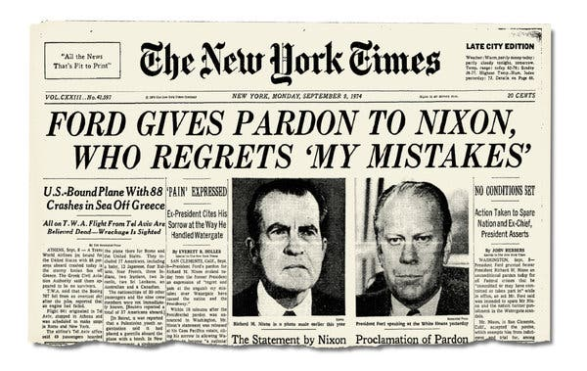
Zero tolerance policy towards fraud
We are committed to ensuring integrity and transparency in all projects under the Interreg Meuse-Rhine Programme.

Slide 63
Zero tolerance policy toward fraud
Fraud, corruption, and any misuse of funds will not be tolerated
All suspicions will be taken seriously and investigated thoroughly
Every report will be treated with discretion and respect
Report (suspicion) of fraud
  You can report any suspicions confidentially to interregmr.fraud@prvlimburg.nl
  A Template for reporting fraud is available
  Find the entire Whistleblowing and Anti-Fraud Reporting Procedure on our website

Slide 64
Public Procurement
Pay special attention
  What is the contract amount? What procurement procedure is required?
    EU threshold changes every two years. Currently for services and supplies: 216.000 €, for central governments 140.000 €
    Below the threshold national public procurement rules apply, strictly follow the applicable procurement rules
    In case of joint procurement follow the rules of the strictest member state/region
    Store all related documents.
Thresholds - European Commission (europa.eu)
Notes:
Especially relevant for cost options 1, 2, & 4. However all of them need to follow the public procurement procedures!

Slide 65
Co-financing
Programme only handles ERDF
Additional financing from other authorities possible
  Process differs per region, see co-financing confirmation
  You have to handle this yourself (except Ministerie EZ and NRW)

Slide 66
Project modification
Bring your project change to the MA/JS if it concerns one of the following:
  Financial: Budget changes > 25% of original partner budget. Total (partner) budget cannot be exceeded!
  Changes in content
  Changes in duration
  Changes in partnership
You need approval by the MA/JS to implement such changes. Depending on the significance of the change, the MA/JS might need approval from the SC.
Notes:
Bigger changes only with MA/JS approval

Slide 67
Communication

Slide 68
Publicity & Communication
Share the fact that the project is supported by EU funds as part of the Interreg Meuse-Rhine (NL-BE-DE) programme (logo & statement)
The programme helps to supply
  Combined logo
  Re-written project description for the target group of the general public (including translation)
  A printed A3 poster per Project Partner
  Permanent plaque or billboard where necessary
  Website space and support filling in the content where needed
Requirement to add a project description on your organisation’s website and social media channels
More information in the Manual
Notes:
10.000 € is for the supplied help by our programme

Slide 69
Project Plaques
> € 100.000 of tangible investments / equipment in your project?
Programme will provide a project plaque to display on designated locations of your investment.
Contact your Project Manager for details.

Slide 70
JEMS-Monitoring

Slide 71
JEMS
Monitoring System
  All project specific information
  All reporting & Management verification information
Extra training
  Explanation how to report in JEMS
  What documents are expected
  Necessity to identify your financial representative (per partner) for this training

Slide 72
What you can already do
Collect pay slips for the first month of the project
Set up a time registration system
Fill in partner details in JEMS

Slide 73
Questions?

Slide 74
Thank you for attending!

